Slide 1
Clean Code&& Solid principles.

Slide 2
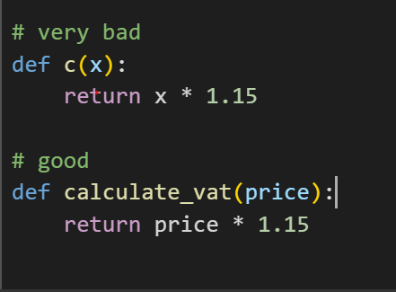
clean code
Writing code that is clear, organized, and easy to understand and maintain, so that any developer (even if they didn't write the code) can read and modify it without difficulty.

Slide 3
Rules of clean code.

Slide 4
Rules
Easy to read and understand
Divided into small functions
Don’t Repeat Yourself (DRY)
Unified format
Smart and concise comments
Commitment to project or language standards for EX (PEP8)

Slide 5
What is the PEP8 ?

Slide 6
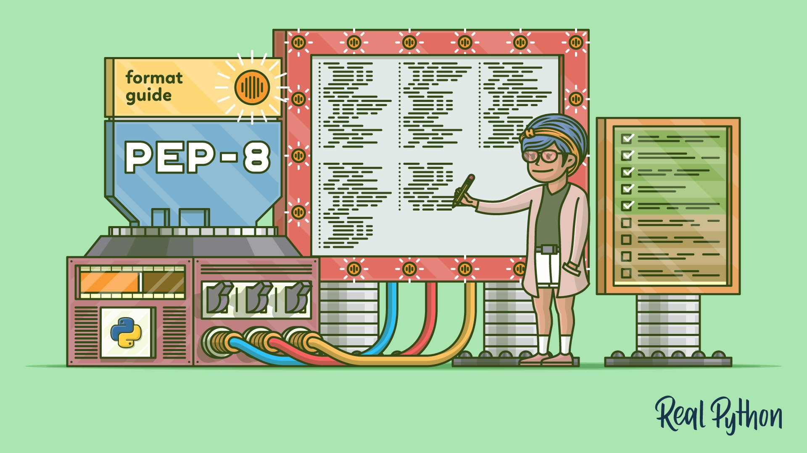
PEP8
PEP 8 is a Python code style guide, a set of rules and recommendations developed by Python Software Foundation

Slide 7
The most important rules of PEP 8
Indentation : Use Tap
Line length : Do not exceed 79 characters per line.
Spaces around calculations
Variable and function names : In lowercase with underscore
Classes : It starts with a capital letter and every new word starts with a capital letter.

Slide 8
What is the Solid principles ?

Slide 9
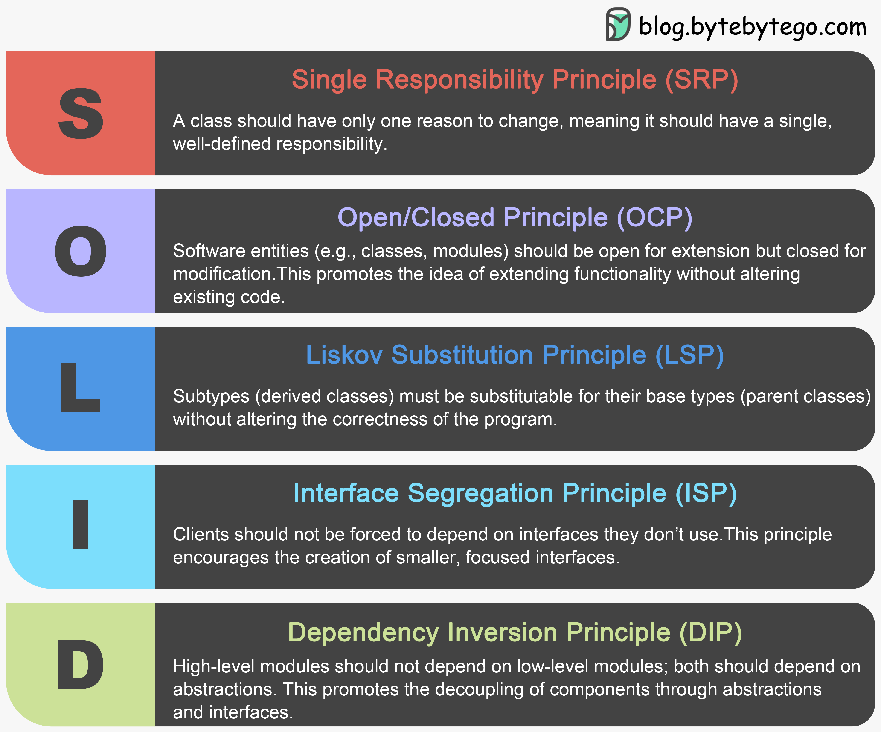
Solid principles
It is a set of 5 basic programming principles in software design (especially in object-oriented programming OOP) that help you write code.

Slide 10
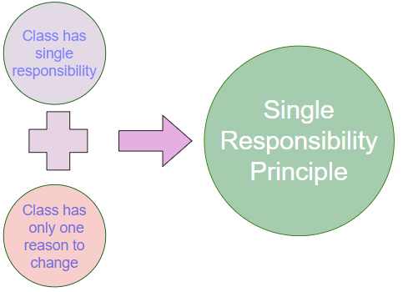
Single Responsibility Principle
Each class or function must have a single reason for change, meaning it must perform only one specific task. If a class is responsible for more than one thing, you will have to modify it every time a change occurs to any of those responsibilities, increasing complexity and the likelihood of errors.

Slide 11
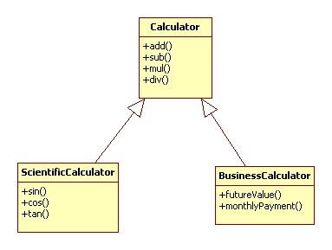
Open/Closed Principle (OCP)
The code should be open for expansion but closed for modification.

Slide 12
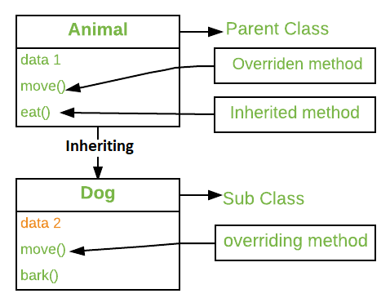
Liskov Substitution Principle (LSP)
It should be possible to replace any subclass with its parent class without affecting the program logic.

Slide 13
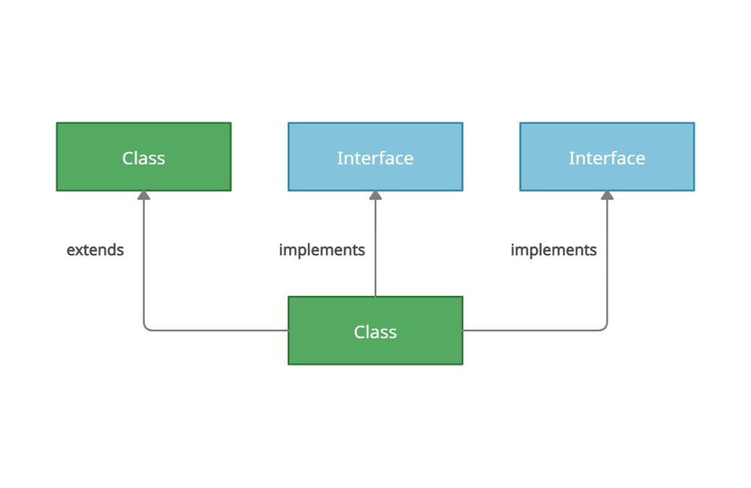
Interface Segregation Principle
Don't force objects to implement interfaces that contain functionality they don't need.

Slide 14
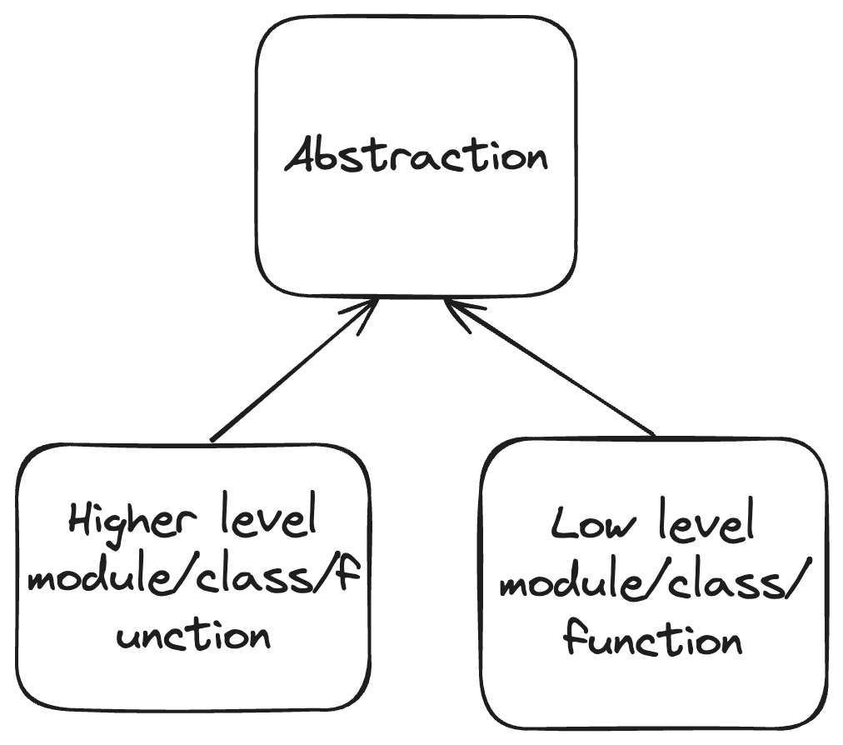
Dependency Inversion Principle (DIP)
Rely on abstractions rather than concrete implementations.

